Slide 1
Factors that Drive Home Prices
Presented by: Sara Hill

Slide 2
Overview
Investors tend to lend money to home buyers using mortgage-backed securities
What are the factors that drive up home prices?
So, what features attract buyers the most to pay more for a house?

Slide 3
The Data
The data used was:
A sample of 1,460 houses
Located in Ames, Iowa
Sold between 2006-2010
There were 82 columns in the original data set, which contains housing information such as: sales price, lot land area, building type, year built, etc.
Data comes from Kaggle.

Slide 4
Hypotheses
I hypothesize that these are the driving factors that affects home prices:
Type of Neighborhood
House/Building Type (i.e., townhouse, condo, 1 bedroom 2 bath, etc)
If the house has a garage, and what type
The year it was built
Overall Condition of the house

Slide 5
Methods Used
2 PivotTables to filter and group by the various types for all the tests
Ran Statistical Excel Analysis ToolPak Descriptive one-sample test to analyze frequency of data distribution
Two sample t-test between two different neighborhoods, building types, garage types, years built, and housing types
Created chart visualizations using Excel

Slide 6
Neighborhood Type
College Creek vs. Old Town
The difference is significant at the < 0.05 level. With 95% confidence, the average sales price for houses located within College Creek is between $57k and $83k higher compared to the houses located in Old Town.
Recommend!

Slide 7
Building Type
Single-Family Detached (1Fam) vs. Townhouse End Unit (TwnhsE)
There is NO difference between the population means, so we fail to reject the null hypothesis.
This difference is NOT significant at the .095 confidence level
Don’t recommend!

Slide 8
Garage Type
Attached to home (Attchd) vs. Built-In (BuiltIn)
The difference is statistically significant at the < 0.05 level. With 95% confidence, the average sales price for houses that have a built-in garage is between $29k and $74k higher than the attached to home garage types.
Recommend!

Slide 9
Year Built
2006 vs. 2010
There is NO difference between the population means
The difference is NOT significant at the .095 confidence level.
Don’t recommend!

Slide 10
Housing Types
2 Story Houses vs. 1 Story Houses
The difference is statistically significant at the < 0.05 level. With 95% confidence, the average sales price for houses that have 2 stories is between $24k and $43k higher compared to 1 story houses.
Recommend!

Slide 11
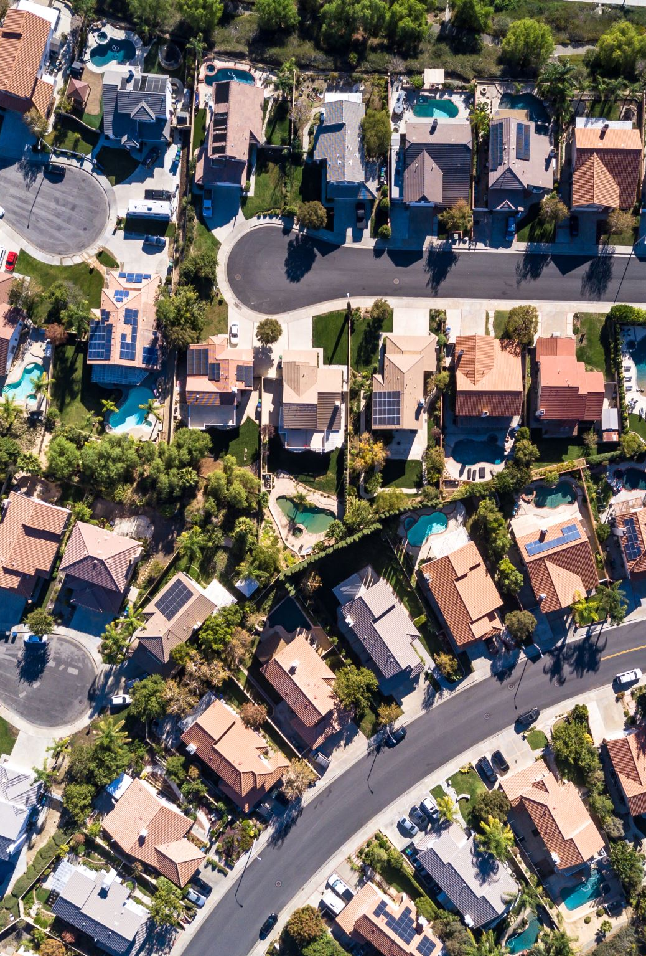
Recommendations
If the buyer is between buying a home in either Old Town or College Creek, recommend buying a home in College Creek
Home with a built-in garage
Different housing types matter! Recommend 2 story homes over 1 story homes

Slide 12
Q AND A

Slide 13

Thank you!

